Slide 1
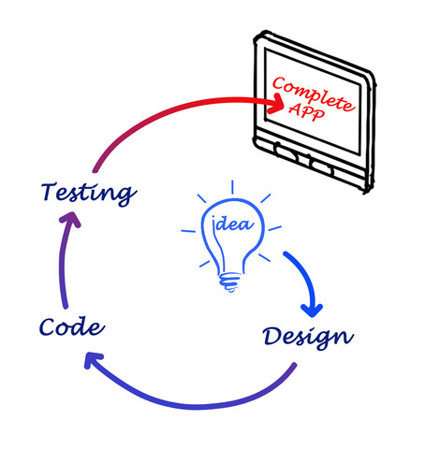
Design

Slide 2

UML (LARMAN)
Use Cases
Use Case diagrammer
Domæne model
Sekvensdiagrammer
GRASP
Design Patterns
Aktivitets diagrammer
Tilstandsmaskine diagrammer

Slide 3

Databaser
Relationelle databaser - ER-diagrammer
Normalisering
Det kender I!

Slide 5
Wish list and OOP-principles
loose coupling: 1 change = ceteris paribus
code reuse (is not the same as copy/paste)
open for extension, closed for modification
encapsulate what varies
single responsibility principle
program against an interface not against an implementation. Dependency injection
prefer composition over inheritance
(in fact this is all the same with different words)

Slide 8

Some Code smells
Duplicate code
Long method, huge class
Similar classes
Conditional complexity(Switch og too many if statement)
No Focus: Classes with too many responsibilities

Slide 9

Design Patterns

Slide 10
Læringsmål:
Vide hvor design patterns stammer fra
Vide hvorfor man bruger design patterns
Genkende områder hvor det kan betale sig at bruge et design pattern
Kunne skrive koden for et design patterne (udføre i praksis)

Slide 11
Design Patterns
Design Patterns Idea originated from Christopher Wolfgang Alexander (Austria).
Architect
It was initially applied for architecture for buildings and towns, But not computer programming for writing software.

Slide 12
"Each pattern describes a problem which occurs
over and over again in our environment, and
then describes the core of the solution to that
problem, in such a way that you can use this
solution a million times over, without ever
doing it the same way twice”
-Christopher Alexander (Architect)
“A Pattern Language”,New York,
Oxford University Press, 1977.

Slide 13
Design Patterns
Even through he was talking about patterns in buildings and towns, what he says is true about object-oriented design patterns.
Solutions are expressed in terms of objects and interfaces instead of walls and doors.
At core both patterns is a solution to a problem in a context.
Simply, design patterns help a designer to get a right design faster.

Slide 14
Original design pattern
Describes a design pattern as a three-part rule
1.) Description of a context
2.) A problem
3.) A solution
This is modified for software design patterns which
consists of four parts.

Slide 15
Four Essential Parts
Pattern name
A handle to briefly describe the design problem, but more importantly to provide a common vocabulary for software designers to use.
Problem
A description of the problem that the design pattern is intended to solve.
Solution
Describes what elements are required to make up the design, their relationships and its context.
Consequences
What are the results and trade offs by applying the design pattern.
Allows comparison between different design patterns, to see if there is a better fit for the actual problem.

Slide 16
Programming languages
Aimed towards languages that have language level support for Object Oriented Programming
Not exclusively, But it would be easier to apply with OOP!
Different OOP languages have different mechanisms for applying patterns.

Slide 17
Types of Patterns
General description of the type of problem the pattern addresses
Creational:
Concerned with everything about the creation of objects
Structural:
Concerned with how classes and objects are composed to form larger structures
Behavioral
Concerned with algorithms and the assignment of responsibilities between
objects.

Slide 18
Creational
Factory
Singleton
Factory Method
Structural
Adapter
Composite
Decorator
Behavioral
Observer
Iterator
Command
Mediator
State

Slide 19
Frequency of use:
High
Define an interface for creating an object, but let subclasses decide which class
to instantiate. Factory Method lets a class defer instantiation to subclasses.

Slide 20
Kilde: Design Patterns

Slide 21
Frequency of use:
High
Provide an interface for creating families of related or dependent objects without specifying their concrete classes.

Slide 23
Frequency of use:
Medium
Attach additional responsibilities to an object dynamically. Decorators provide a flexible alternative to subclassing for extending functionality.

Slide 24
Kilde: Design Patterns

Slide 25
Frequency of use:
High
Provide a way to access the elements of an aggregate objectsequentially without exposing its underlying representation.

Slide 26
Kilde: Design Patterns

Slide 27
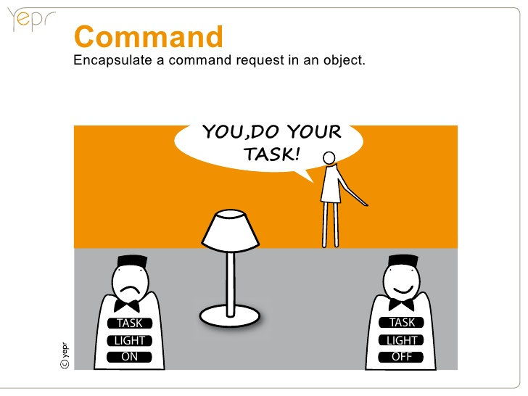
Frequency of use:
Medium high
Encapsulate a request as an object, thereby letting you parameterize clients with
different requests, queue or log requests, and supportundoable operations.

Slide 28
Kilde: Design Patterns

Slide 29
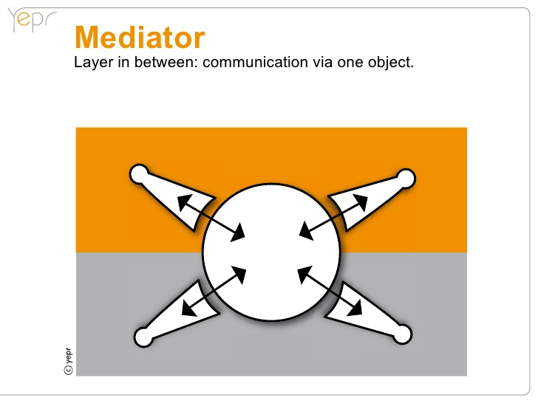
Frequency of use:
Medium low
Define an object that encapsulates how a set of objects interact. Mediator promotes loose coupling by keeping objects from referring toeach other explicitly, and it lets you vary their interactionindependently.

Slide 30
Kilde: Design Patterns

Slide 31
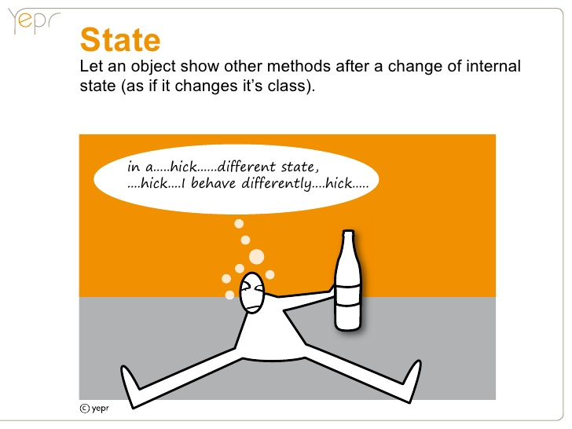
Frequency of use:
Medium
Allow an object to alter its behavior when its internal state changes. The object will appear to change its class.

Slide 32
Kilde: Design Patterns

Slide 33
Opgave
Se Fronter

